Slide 1
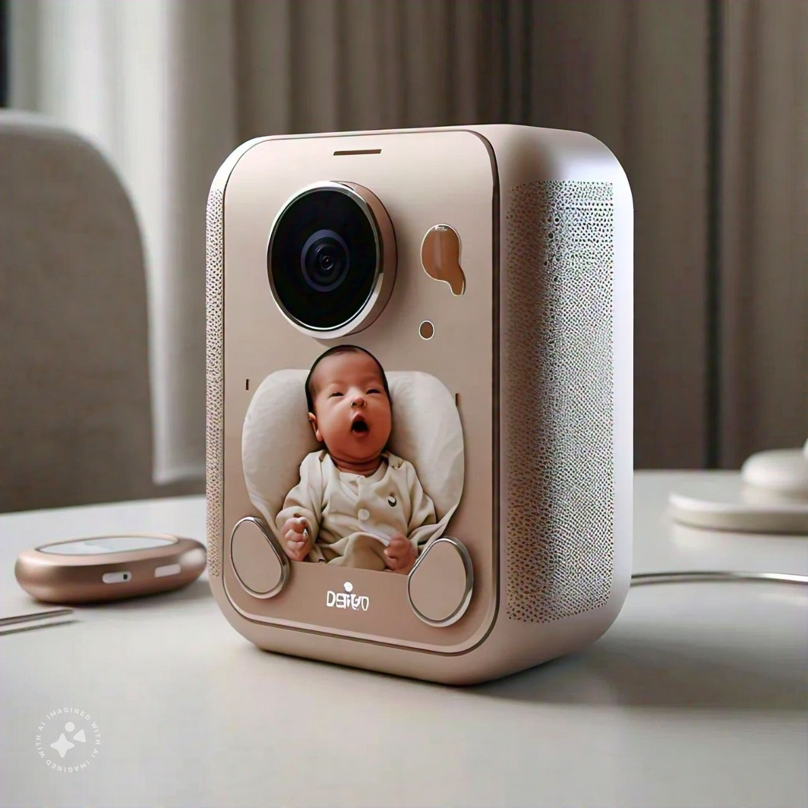
BABY MONITERING DEVICE

Slide 2
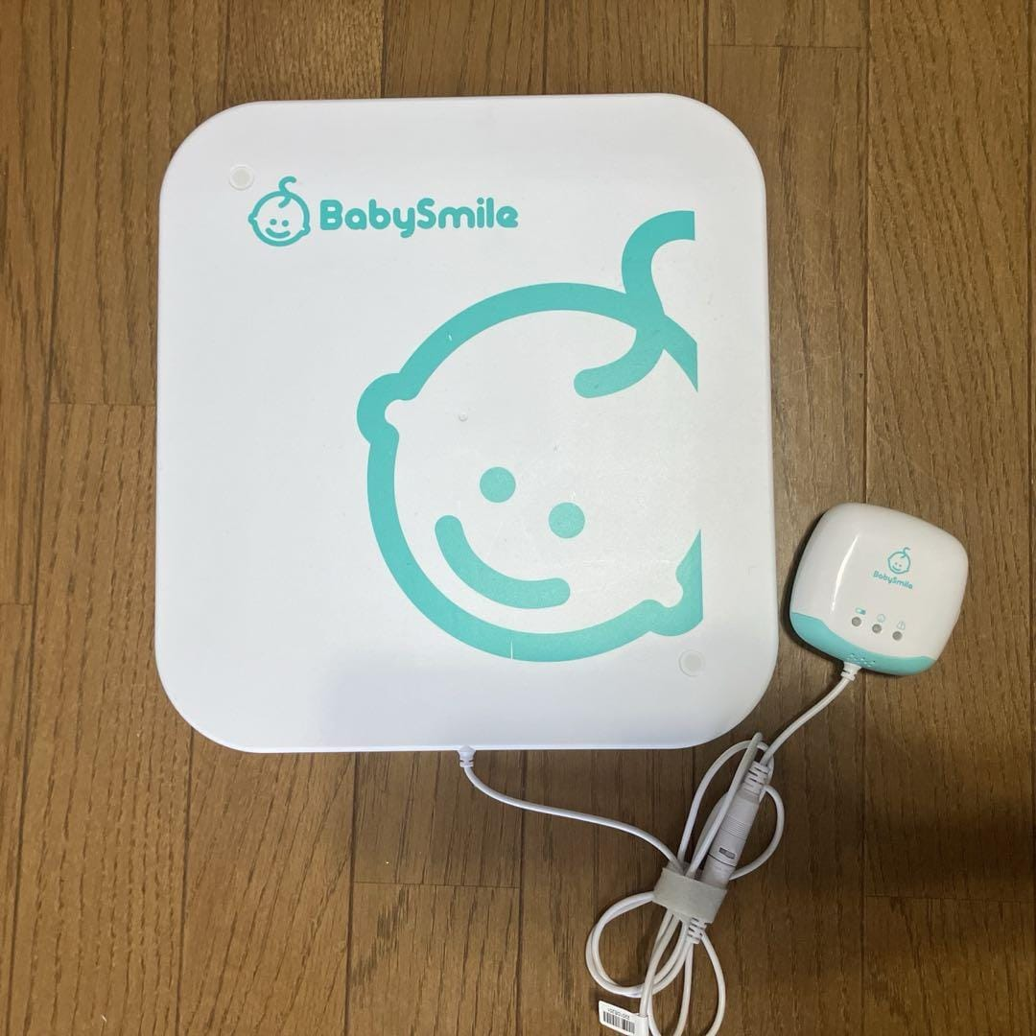
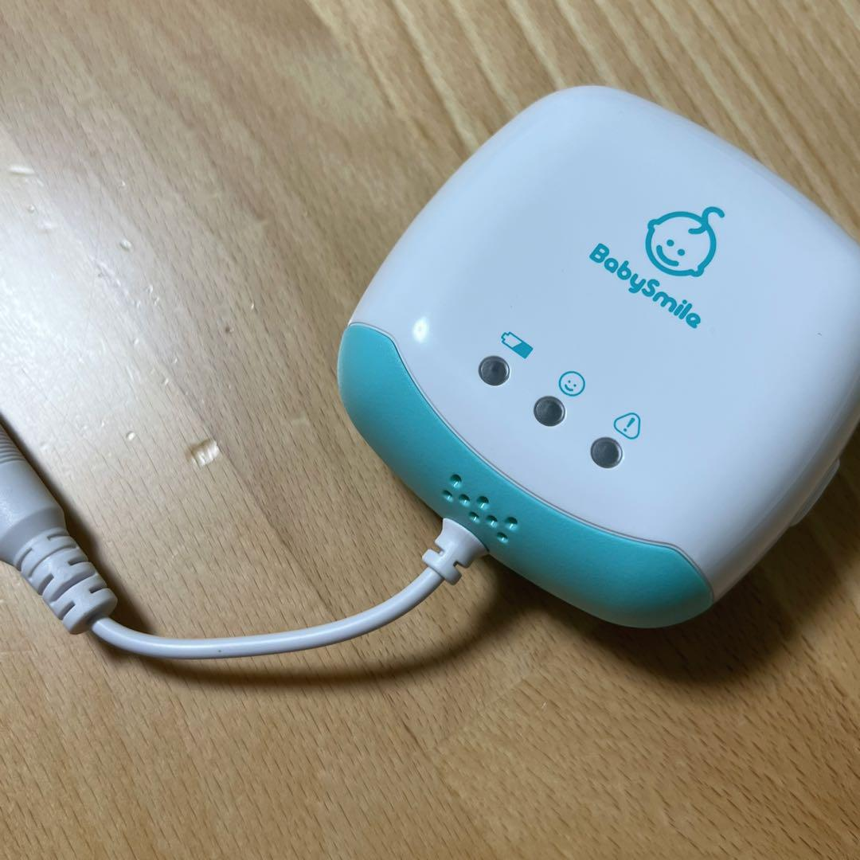
EXISTING PRODUCT
Infant Baby Movement Sensor Baby Alarm E-201

Slide 3
EXISTING PRODUCT FEATURES
Power supply: 3 AA alkaline batteries Rated voltage: DC 4.5V
Battery life: 8 hours per day, about 1 month Applicable weight: 2～10kg
Product size/weight:
controller ~about W70*H70*D35mm, about 61g (excluding battery)
sensor board ~about W280*H300*D12mm, about 420g
Target age: Newborn (0~12 months)

Slide 4
HOW TO USE:
Connect the wire to the end of the controller, place the sensor board on the bottom of the bed, and lay down the mattress.If the baby not is that surface the sensor sensed for more than 20 seconds, the alarm will operate.
Detection mechanism:
Piezoelectric sensor type- These sensors operate based on the piezoelectric effect, where certain materials generate an electrical charge in response to mechanical stress.
Alarm Indication:
Time Interval: If no movement is detected for a specific duration, usually around 20 seconds, an alarm is triggered.
The alarm can be visual LED indicator
beeping sound to alert caregivers immediately.

Slide 5
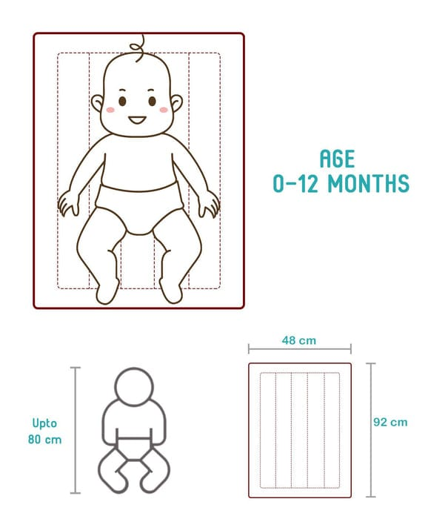
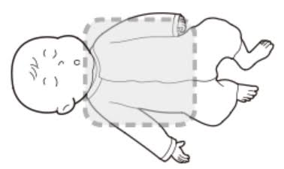
SENSING MAT SURFACE
NOT COMFORTABLE SURFACE
COMFORTABLE SURFACE

Slide 6
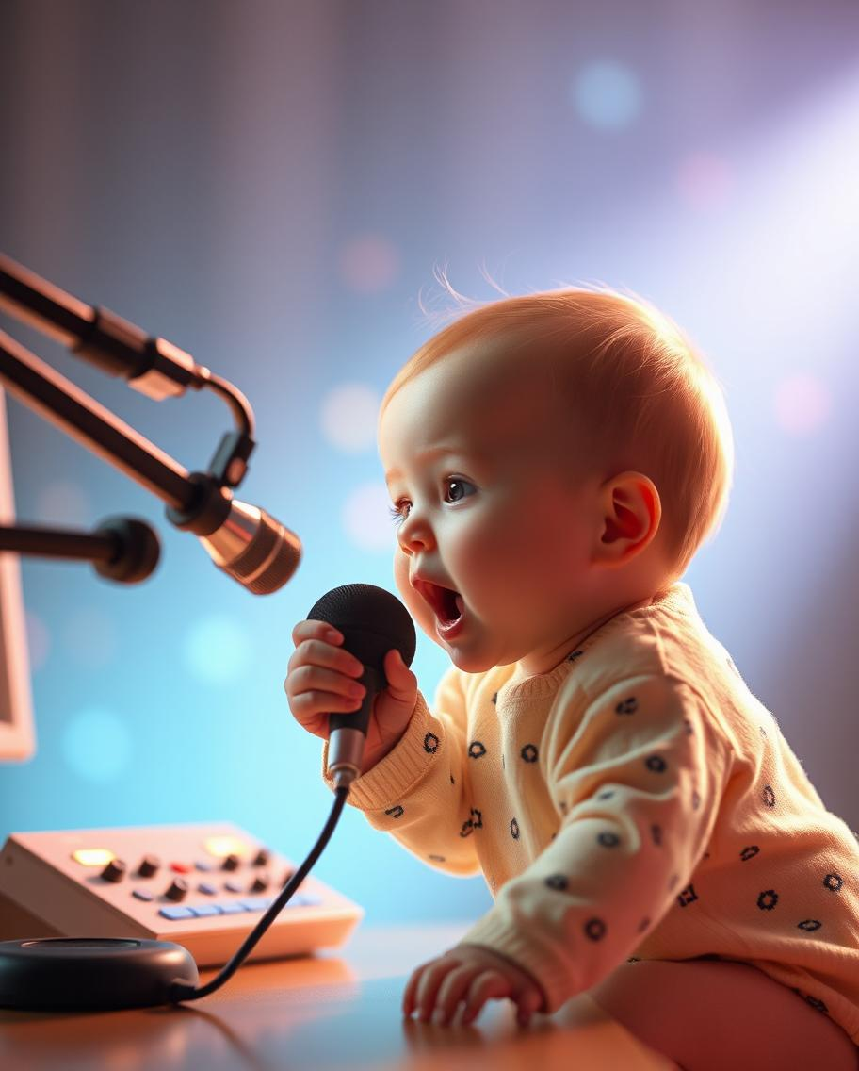




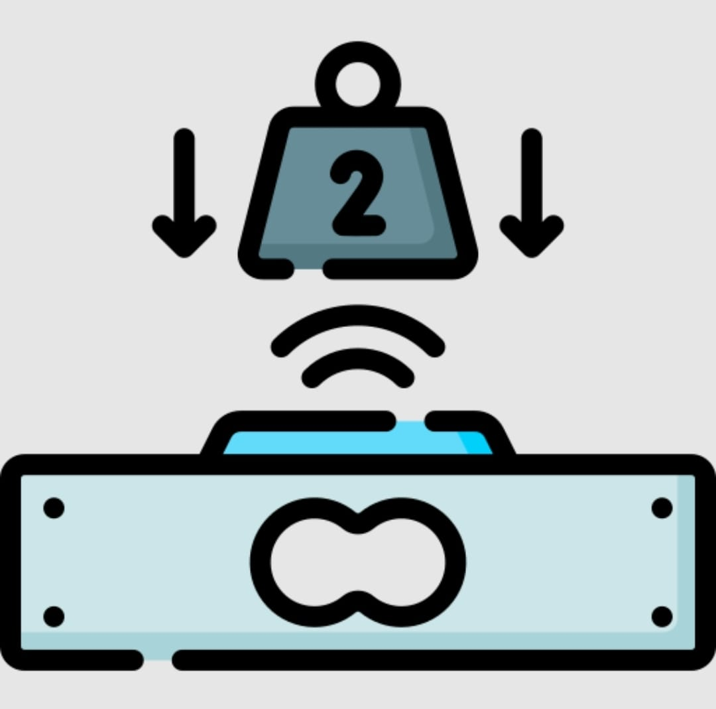
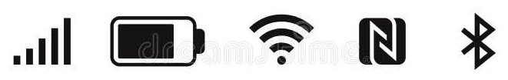


FEATURES
Components
Mic(Microphone)
Speaker
Oxygen sensor
Room temperature sensor
Weight sensor
IOT(Bluetooth,wifi,GSM)
Application
camera

Slide 7
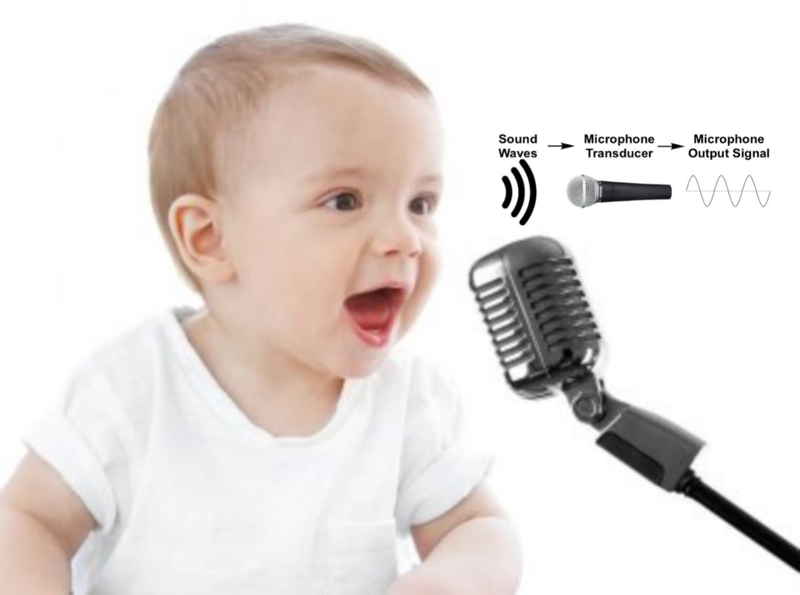
MIC (Microphone)
Continuous Monitoring:
Monitors the baby’s sounds at all times.
Cry Detection:
Detects when the baby is crying and sends feedback to the application.
Persistent Cry Alert:
If crying continues, it alerts the parents via phone and generates a warning sound.

Slide 8
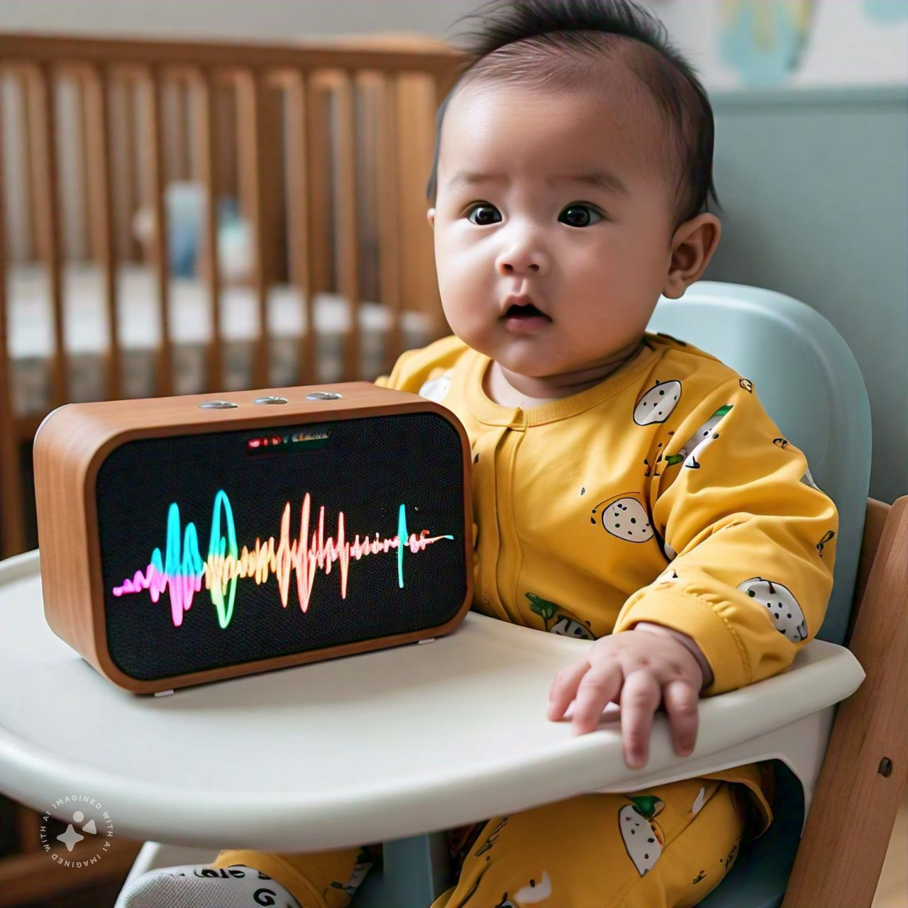
SPEAKER
Direct Communication:
Allows parents to speak directly to the baby through the phone and the Baby Smile module.
Alerts:
Generates warning sounds to indicate to the parents that the baby needs attention.
Smoothing Sounds:
Plays smoothing melodies and natural sounds to comfort the baby

Slide 9
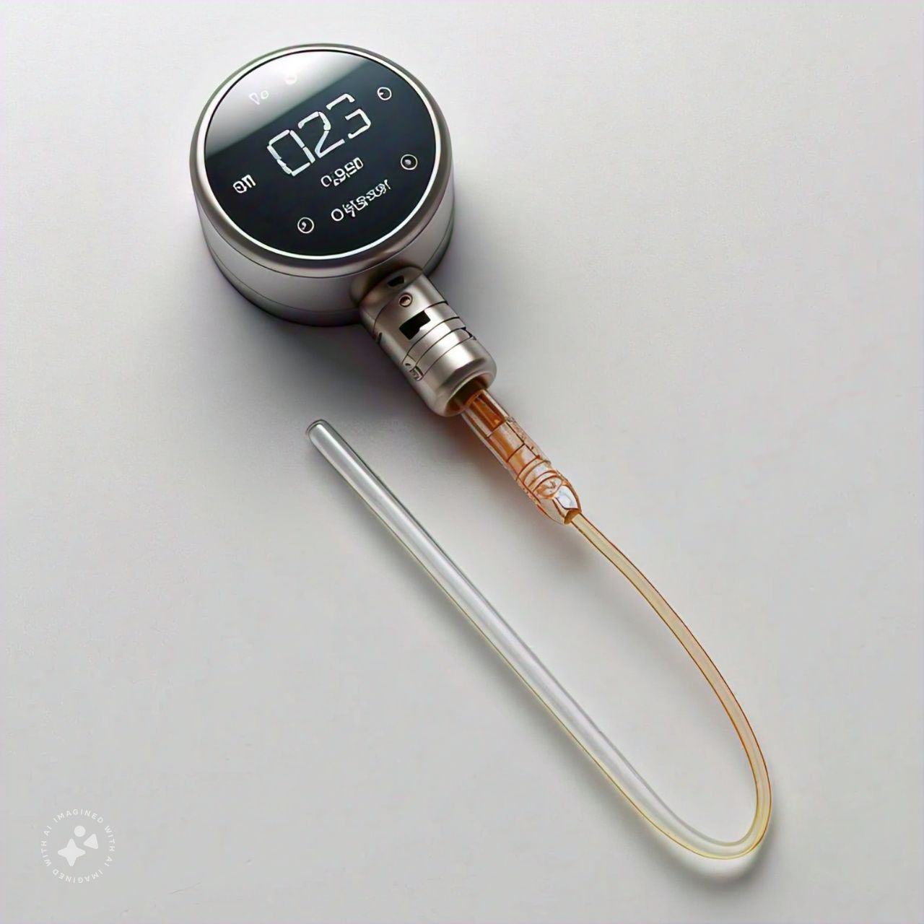
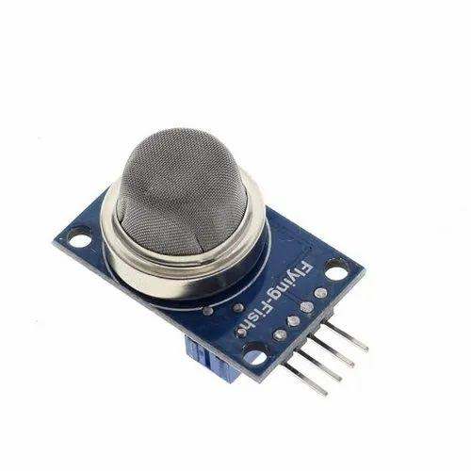
OXYGEN SENSOR
Continuous Monitoring:
Tracks oxygen levels, CO2 levels, and harmful gases in the environment.
Real-Time Feedback:
Sends continuous updates to the application about the gas levels and environment status.
Alerts:
Generates a warning sound and notifies the parents via phone if any issues are detected.
Application Status Update:
Provides detailed information on CO2 and O2 levels, as well as any harmful gases detected.

Slide 10
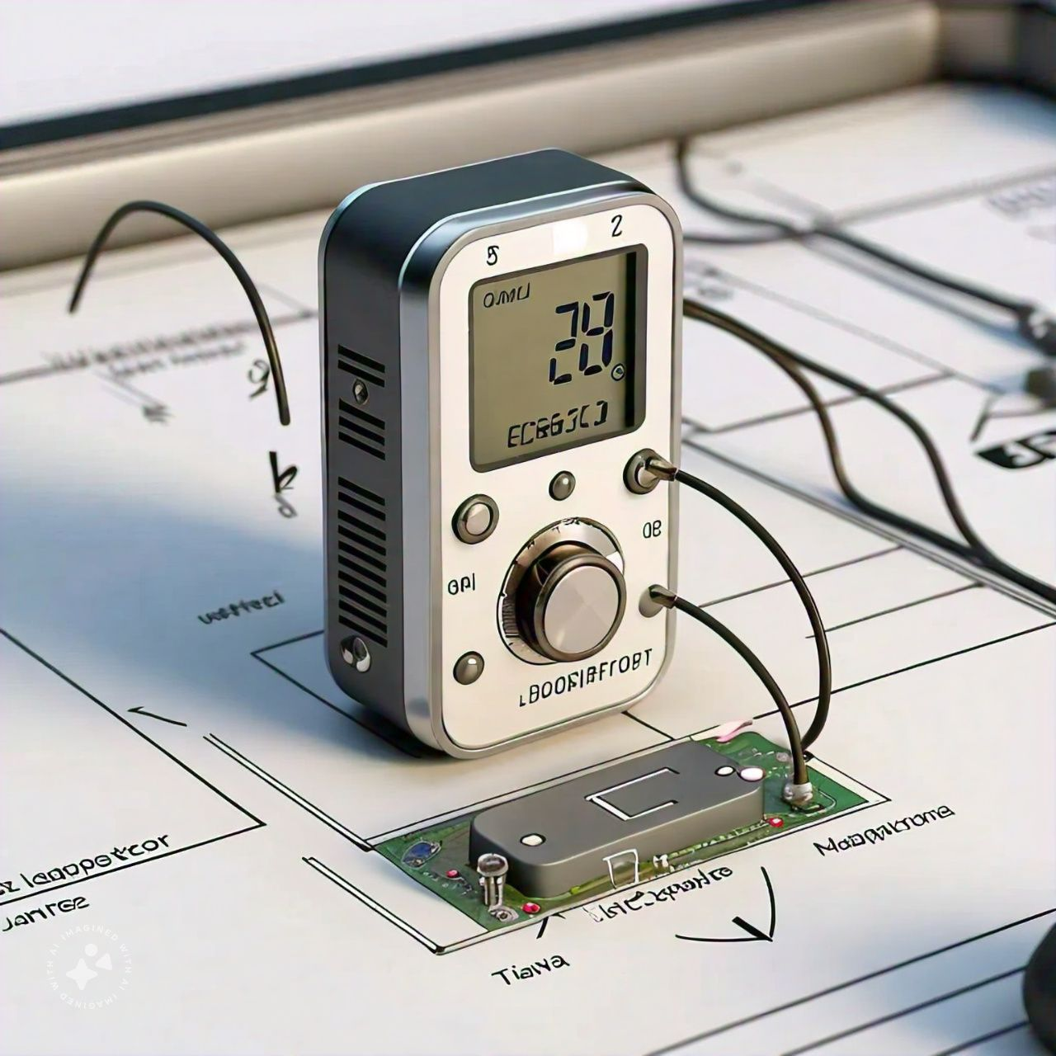
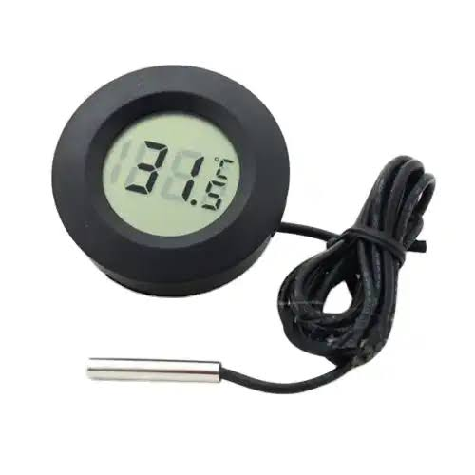
ROOM TEMPERATURE SENSOR
Continuous Monitoring:
Continuously tracks the room temperature and updates the application.
Automatic Fan Control:
Activates the fan automatically if the room temperature rises.
Temperature Limit Alert:
If the temperature exceeds the maximum and Minimum limit despite the fan running, the sensor alerts the parents via phone and generates a warning sound.

Slide 11
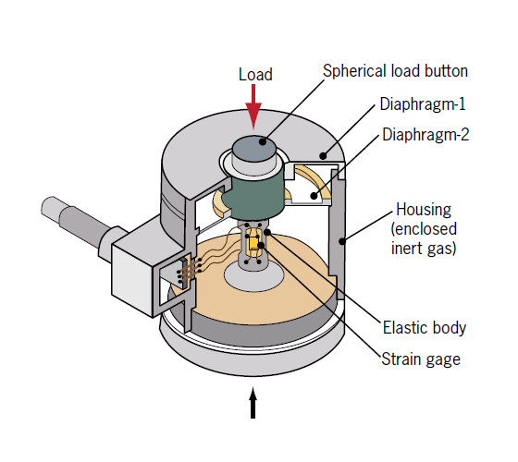
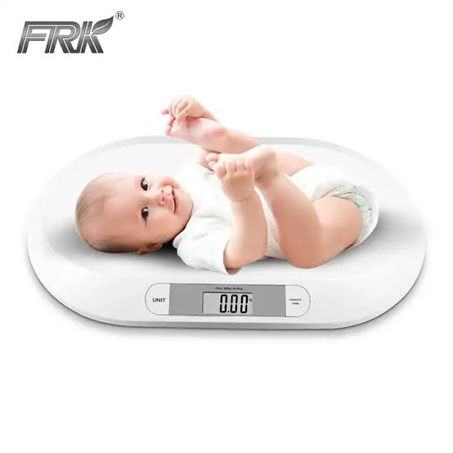
WEIGHT SENSOR
Continuous Monitoring:
Tracks the baby’s weight continuously and updates the application.
Daily Weight Tracking:
Records weight data daily to monitor the baby's health and generate a weight graph in the app.
Movement Detection:
Detects if the baby is moving or stationary.
Alerts the parents via phone and generates an alarm if the baby is moving.

Slide 12



IOT (Bluetooth, WiFi, or GSM)
Data Transmission:
Transmits data from the Baby Smile module to the application using one of the following modules:Bluetooth, WiFi, or GSM.
Module Selection:
The module used (Bluetooth, WiFi, or GSM) depends on the specific requirements and availability.
IoT Concept:
Implements the IoT concept to enable efficient and reliable data communication.

Slide 13
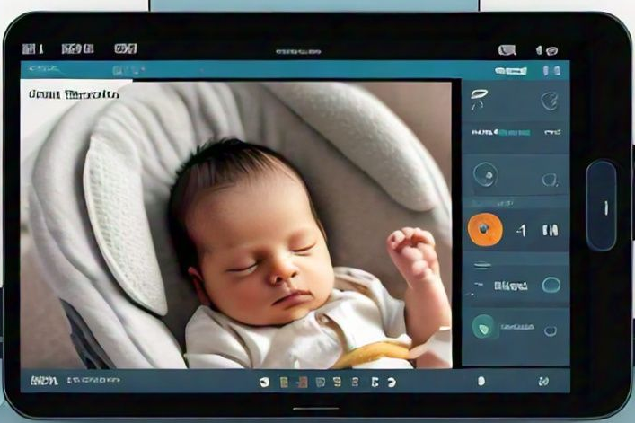
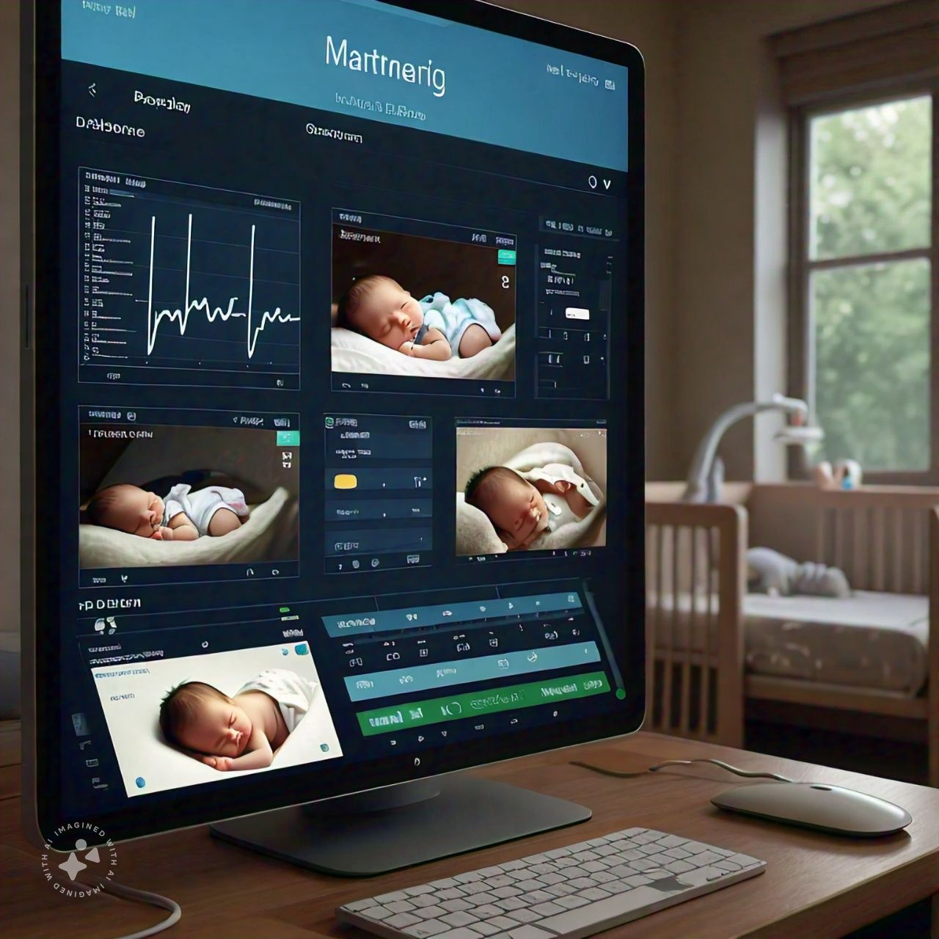
APPLICATION
Data Monitoring:
Monitors and displays all data received from the Baby Smile module.
Parental Controls:
Enables parents to manually control the fan speed.
Allows parents to play music for the baby.
Live Interaction:
Facilitates live conversations with the baby through the app.

Slide 14
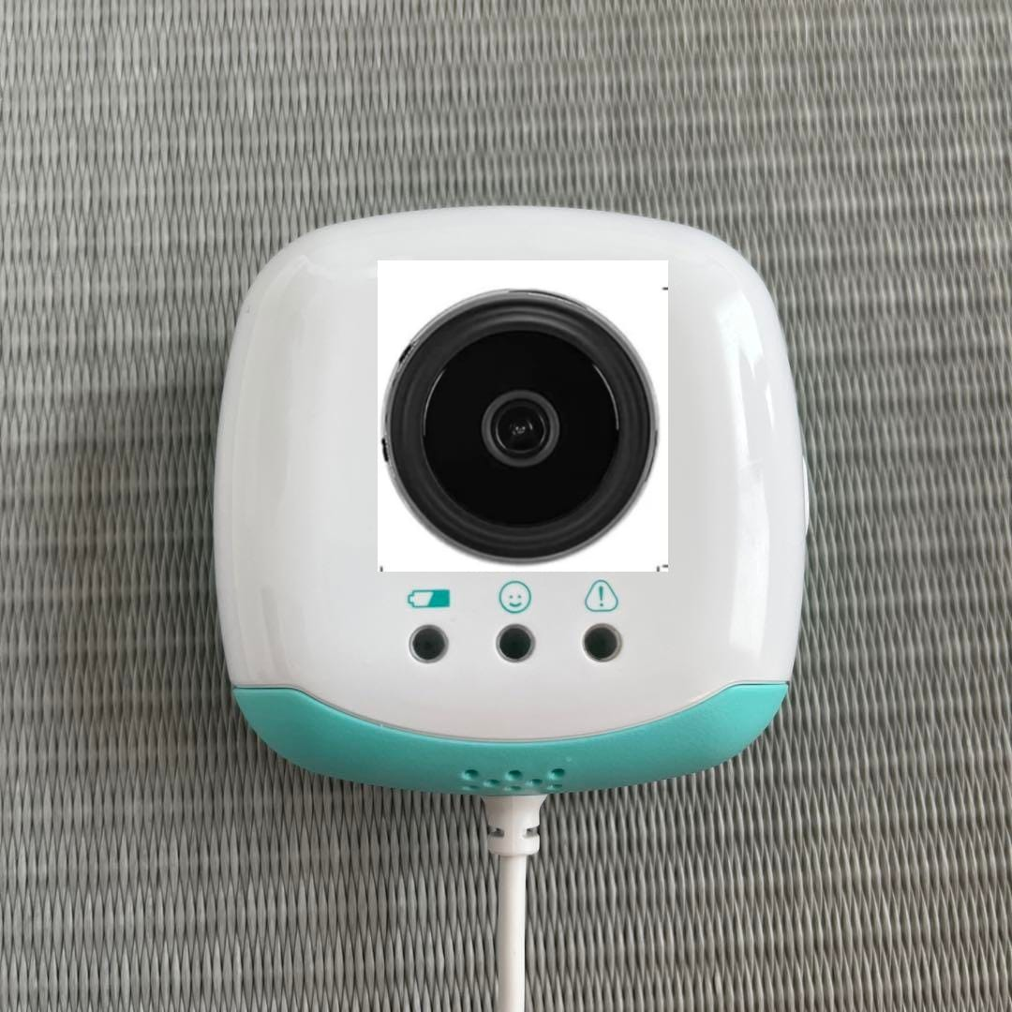
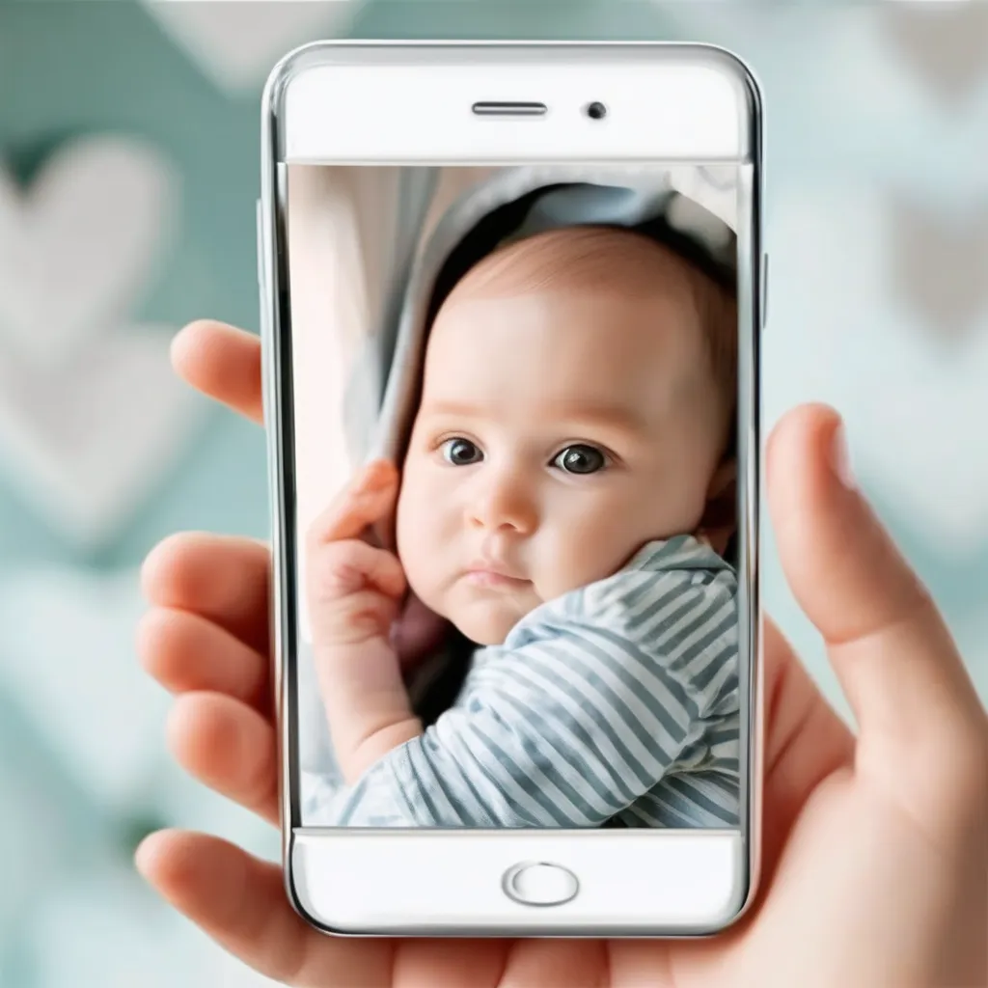
CAMERA
DataSaving:
Some memorable moments video data save memory (eg:baby first pronunciation word videochip stored in memory)
Parent Live Interaction:
Cameras in baby monitors allow parents to watch live footage of their baby in real-time. This enables them to check on their baby's activities, sleeping patterns, and general well-being from another room or even remotely via a smartphone app.

Slide 15
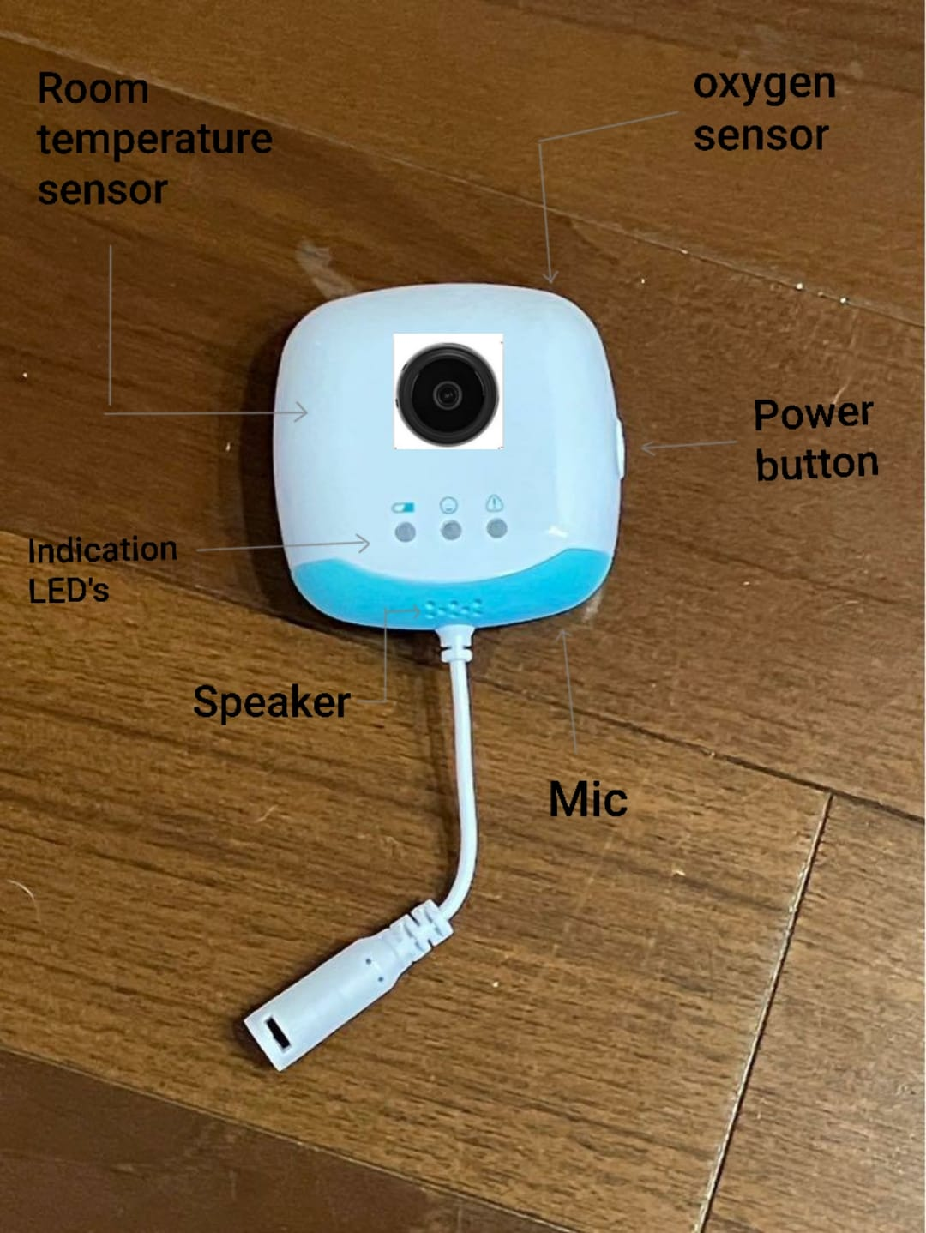
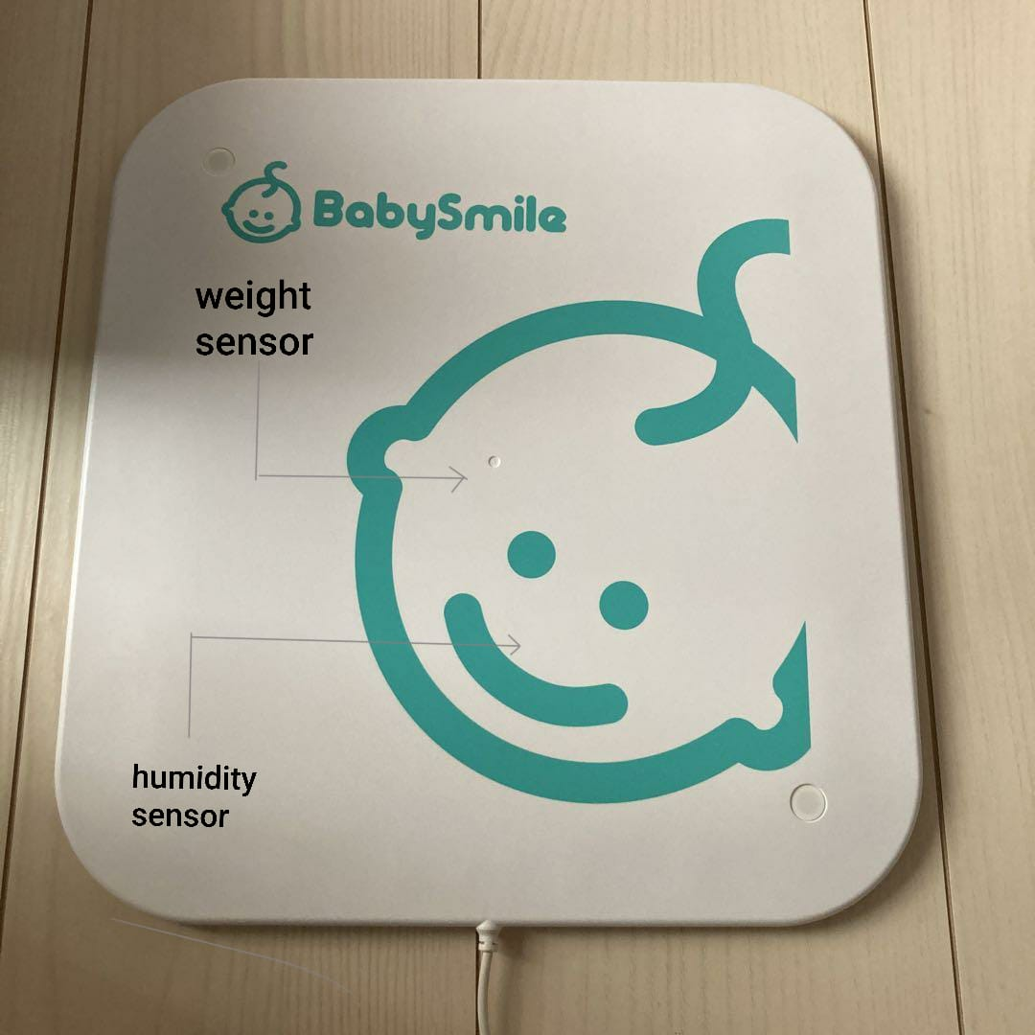
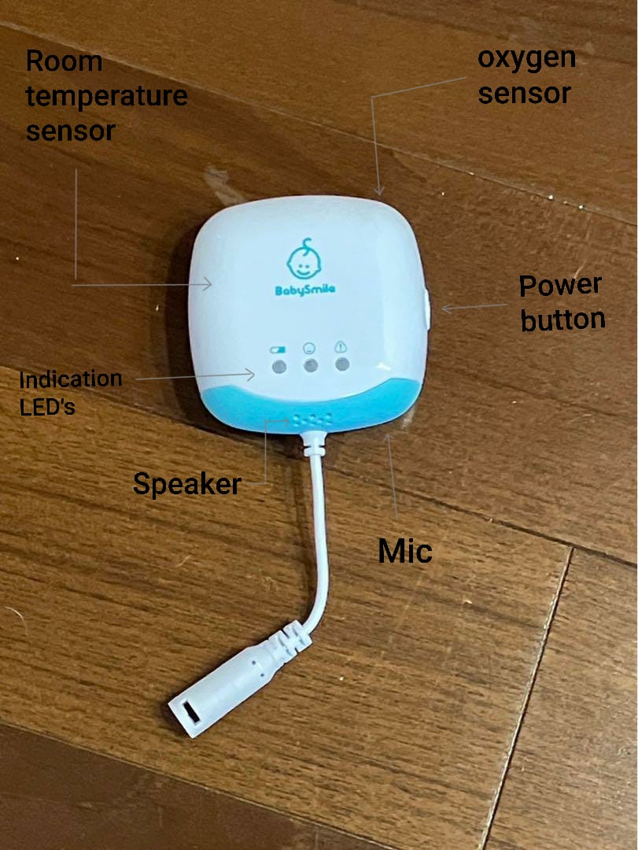
WITH CAMERA
WITHOUT CAMERA

Slide 16
DIFFENENTS :
WITHCAMERA | WITHOUT CAMERA
Monitoring Baby Always for Image processing. | Check movement to predict the baby.
Weight not calculated. | Weight calculated
Heating not created. because all sensors are fixed in the module. | Sensors are fixed on the mat. so heating is possible.
No need for cleaning. | Need Proper cleaning for gems production.
Visual Conformation. | Without Visual conformation.
Provide a Richer Interactive monitor. | Privacy and Simplicity.

Slide 17
THANK YOU

